Slide 1
Comparative genomics of apicomplexans – with a focus on large gene families
Adam Reid
Wellcome Sanger Institute/LSHTM
LSHTM Pathogen Genomics 2021

Slide 2
Summary
Eimeria comparative genomics
Food security, crazy repeats and host-parasite interactions
Plasmodium chronic infection
Malaria, long reads and RNA-seq

Slide 3
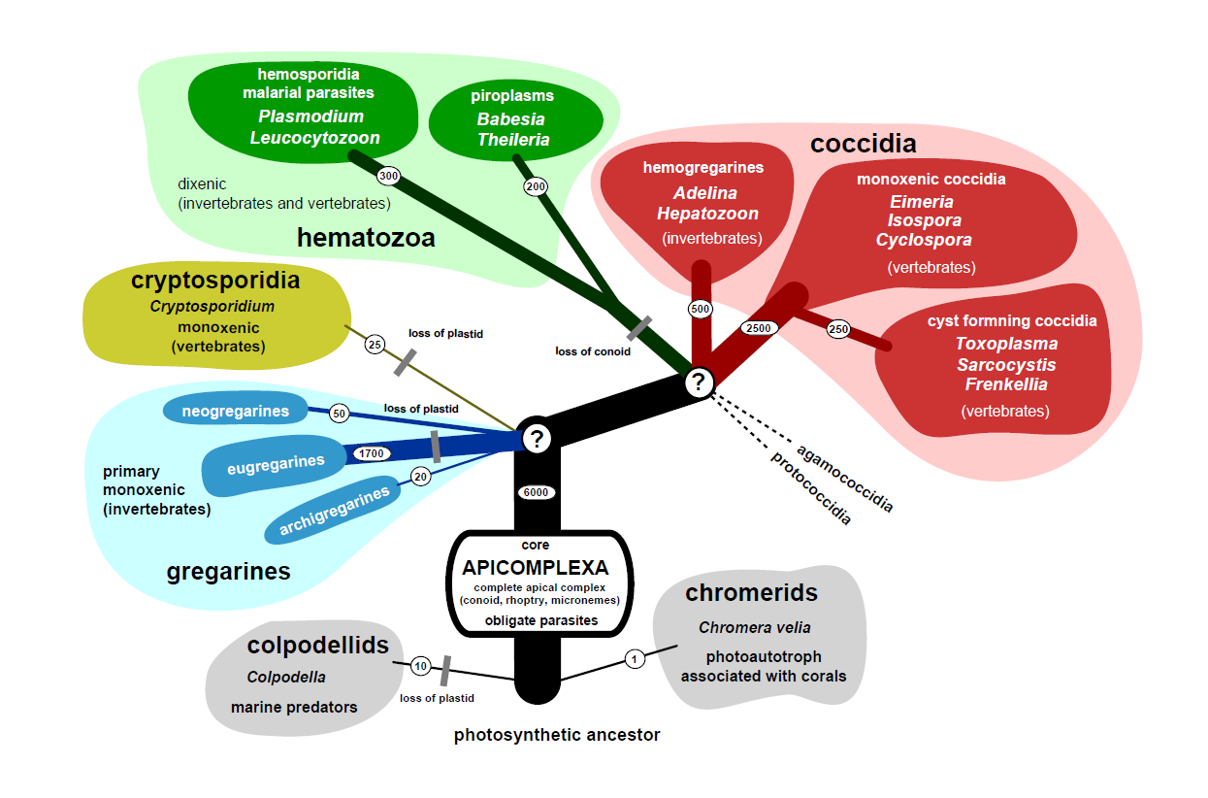
Apicomplexa
© 2011 Jan Šlapeta

Slide 4
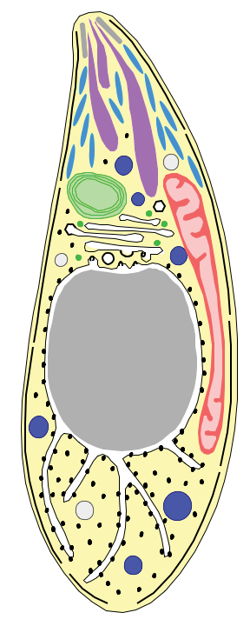
Apicomplexa
Entirely parasitic group of protists
>5000 described species
Seven genera infect humans: Plasmodium, Babesia, Cryptosporidium, Isospora, Toxoplasma, Cyclospora and Sarcocystis
Several other are important livestock parasites: Neospora, Eimeria, Theileria
Micronemes
Rhoptries
Surface antigens
Dense granules

Slide 5
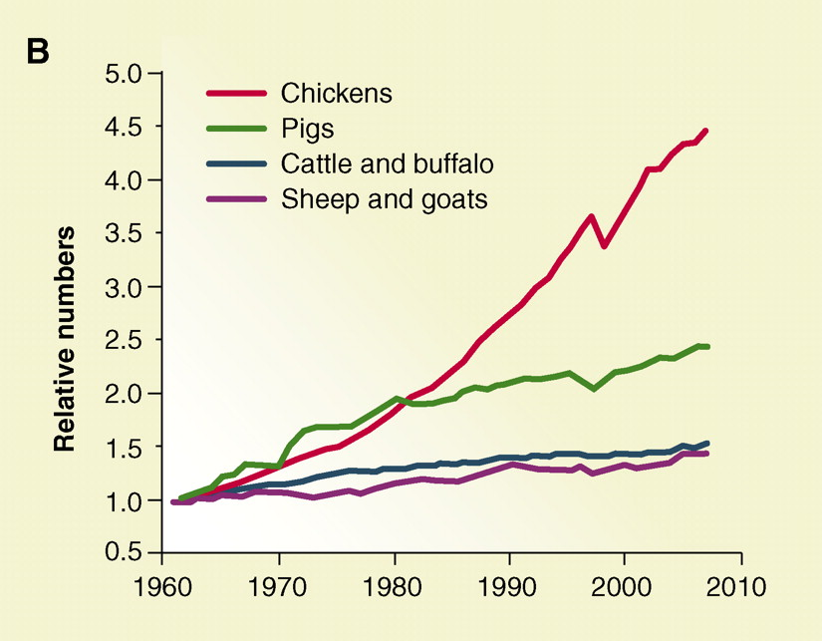
Ensuring food security
Godfray et al., Science 2010
Notes:
In order to ensure food security worldwide we must increase productivity without increasing land use.
One part of achieving this is to develop cheap, multivalent vaccines for Eimeria, one of the most important parasites of domestic chickens.
In order to develop these vaccines we need the parts list of vaccines candidates and we need to better understand the basic biology of the parasite and how it interacts with its host.
We have achieved the first step by sequencing the genomes of all seven species of Eimeria which infect domestic chickens. We have also used this data to go a little way towards improving our understanding of the basic biology of the parasite.

Slide 6
Fascinating biology
Parasitology
Adaptation to a simpler life cycle than other Coccidia (e.g. Toxoplasma)
Genome biology
Hints about unusual genome structure
Host-parasite interactions
Tissue specificity
Interaction with the immune system
Notes:
In Toxoplasma we know quite a lot about genes involved in host-parasite interactions, but largely in the intermediate host. Are similar sorts of genes important in definitive hosts? Does a simpler life cycle mean simpler parasites? …..
Earlier work on parts of the E. tenella genome has suggested a very unusual genome structure
Developing a general interest in interaction with host immune system. Fascinated by the way each parasite develops new gene families for this purpose.

Slide 7
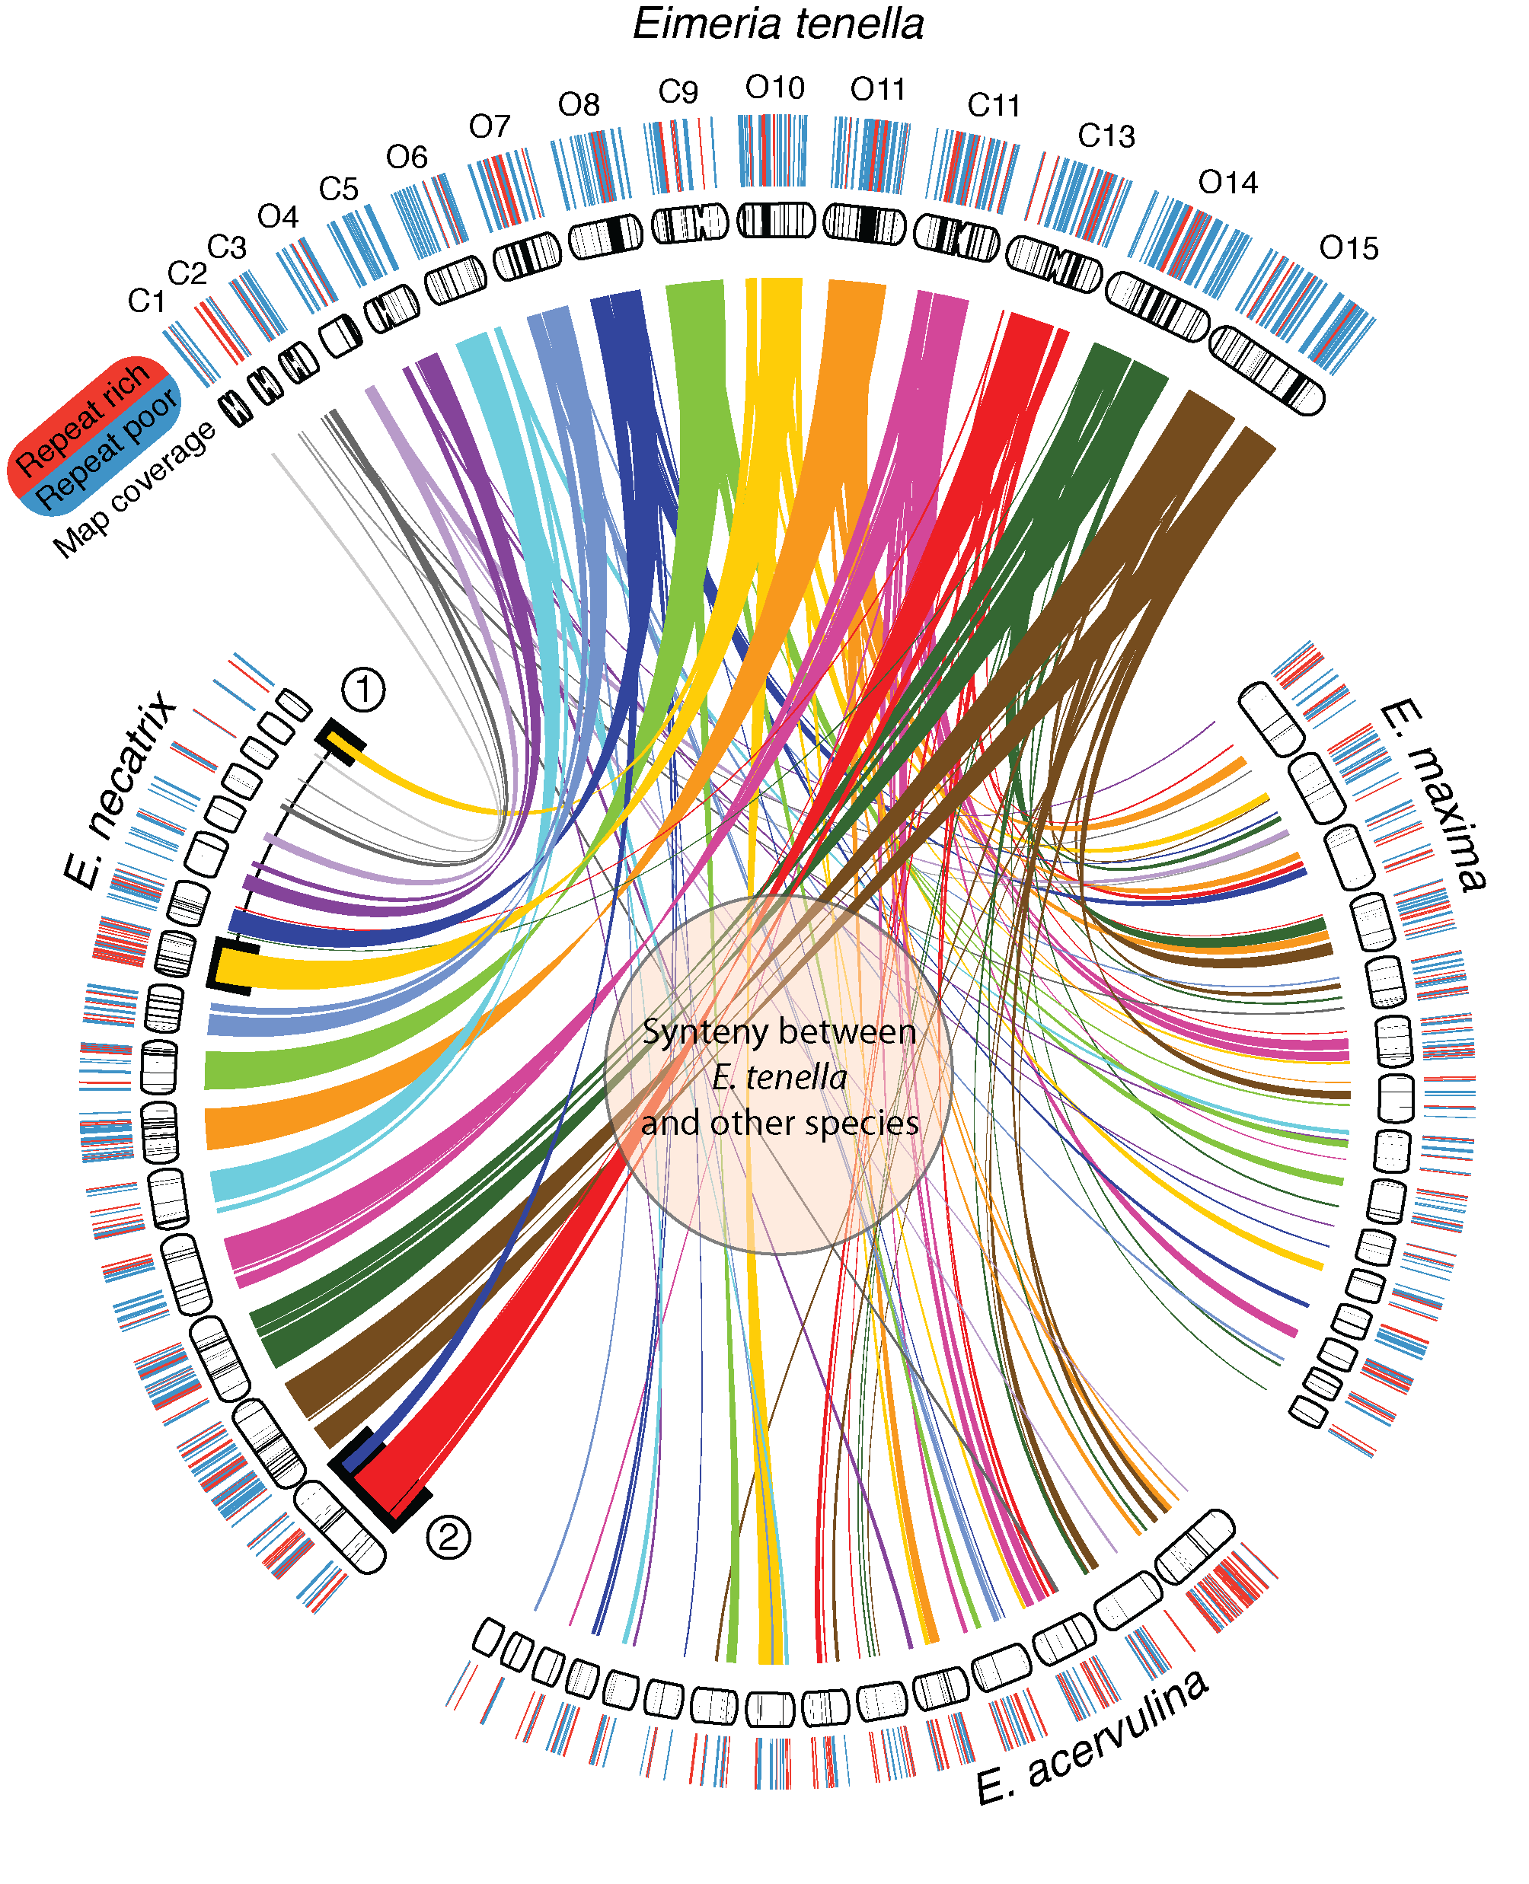
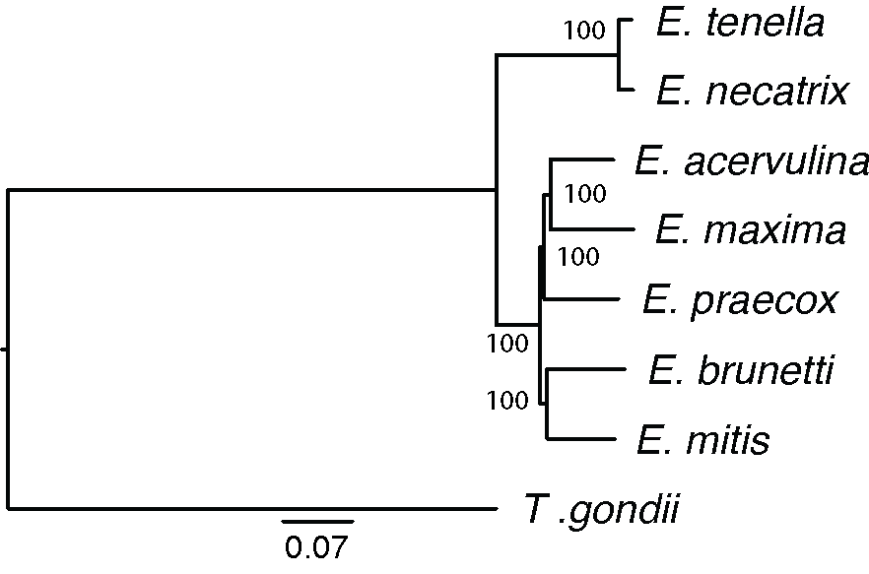
Phylogeny and synteny
Reid et al. (2014), Genome Research
Notes:
Improved resolution of the larger clade, which makes sense with sag antigen genes
Arranged much of the E. tenella data into chromosomes.
Much synteny lost between clades
Pattern of repeat rich/poor regions common to all chromosomes of all species

Slide 8
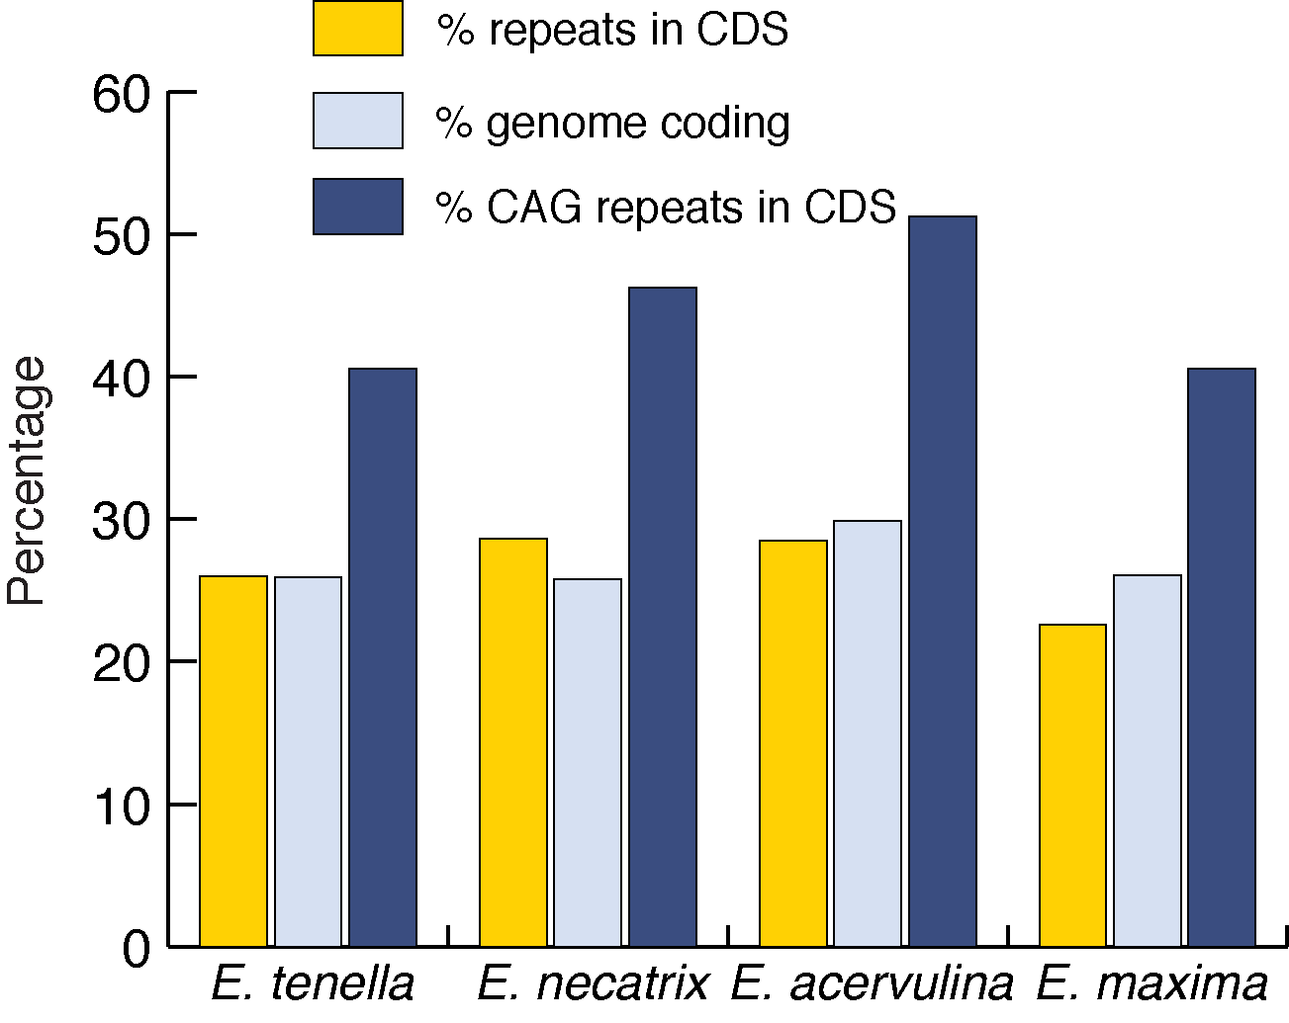
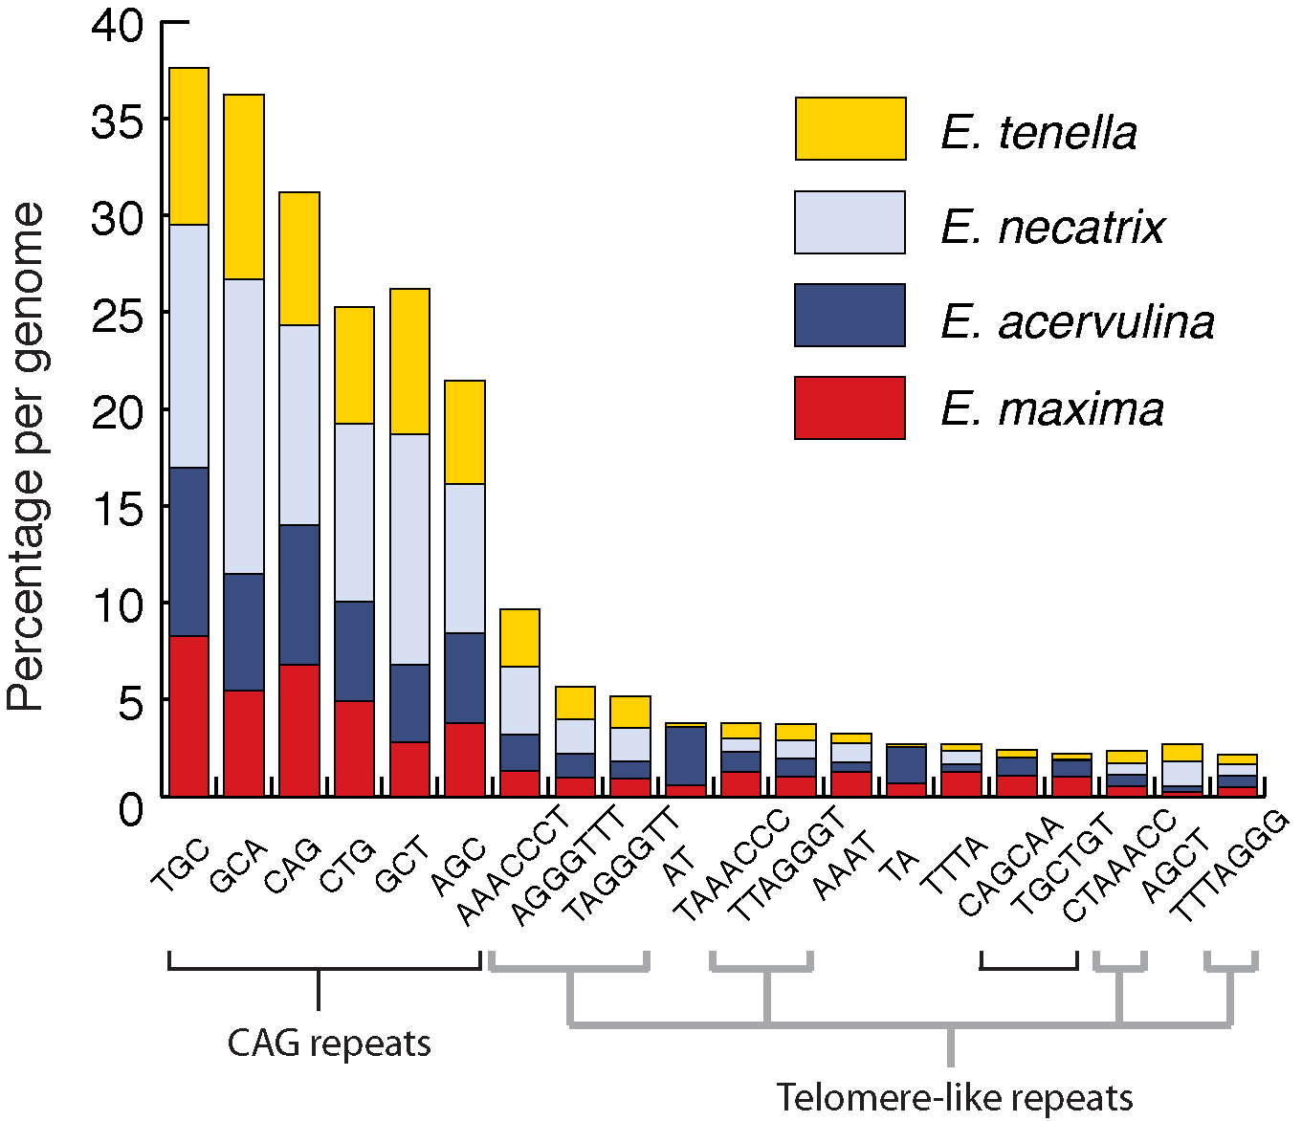
Eimeria genes are littered with repeats
Reid et al. (2014), Genome Research
Notes:
These repeats are more often CAG-related than anything else and these are enriched in coding regions.

Slide 9
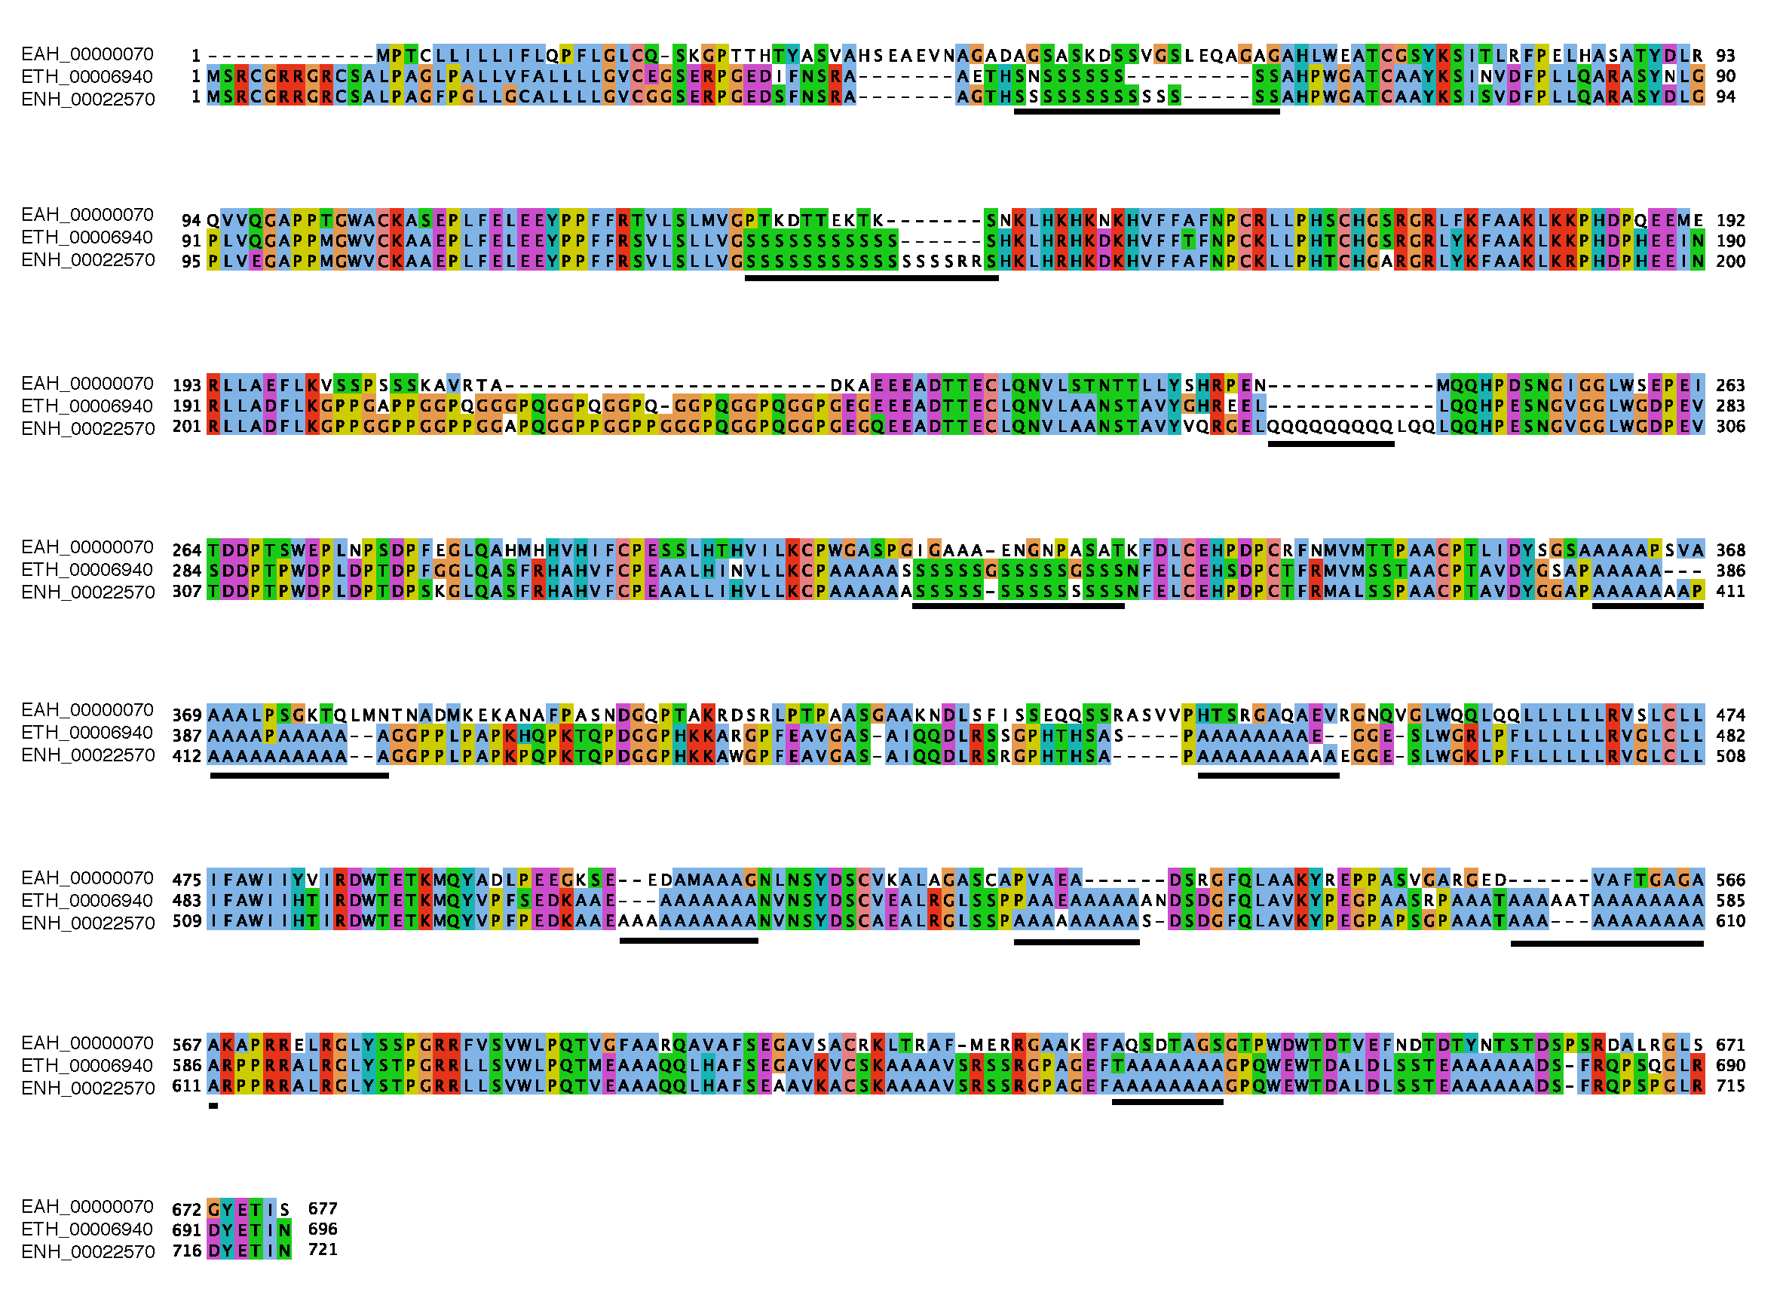
Eimeria proteins are littered with repeats
Reid et al. (2014), Genome Research
Notes:
The repeats result in strings of single amino acids, mostly A, Q or S.
There are more HAARs in Eimeria than in any other species examined and they are distinct from those of closely related species.

Slide 10
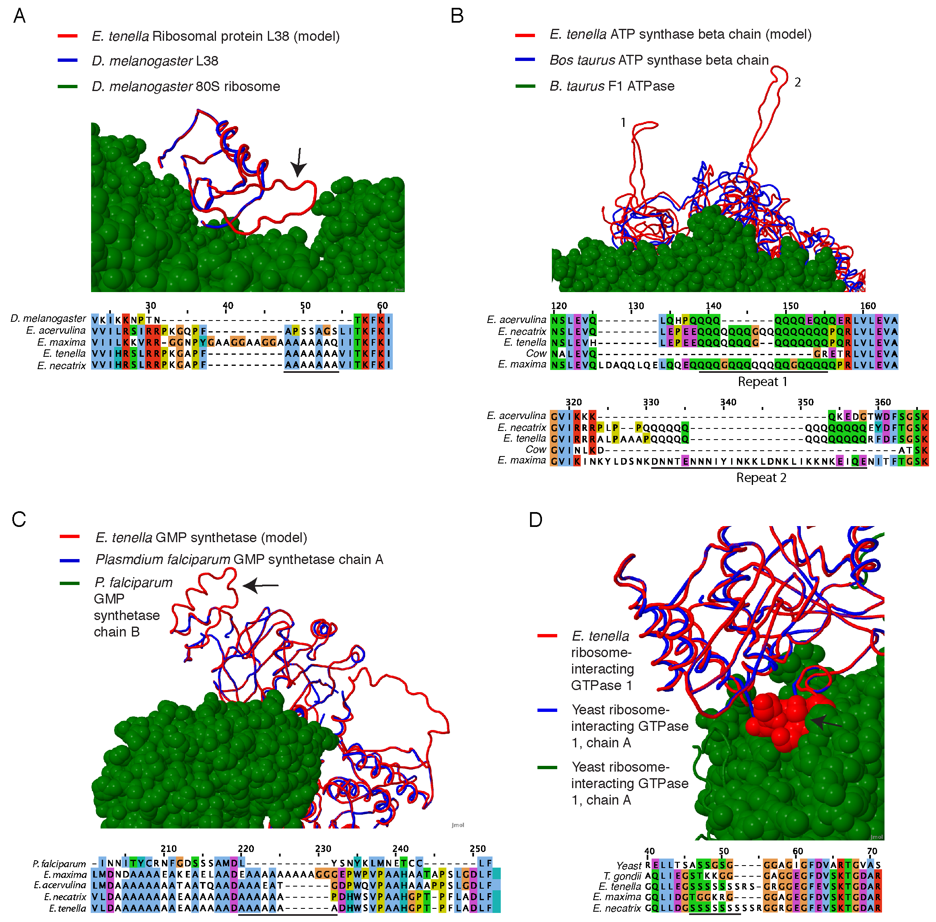
Notes:
These repeats appear to be structurally neutral in most cases.
Could their function lie at the level of the genome sequence, but be tolerated in protein sequences?

Slide 11
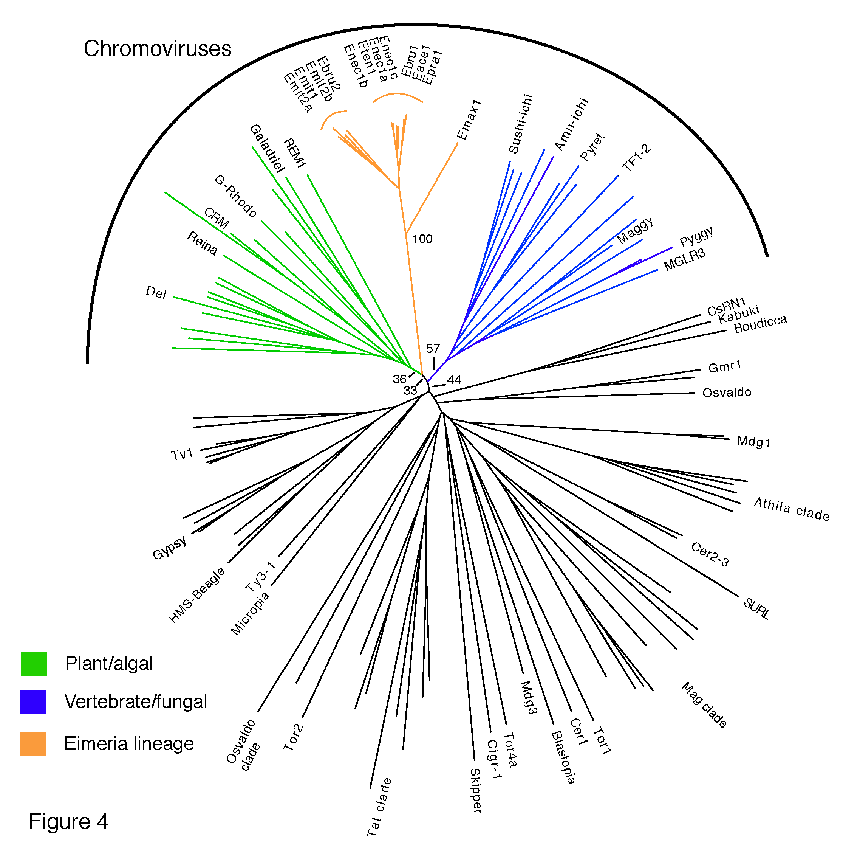
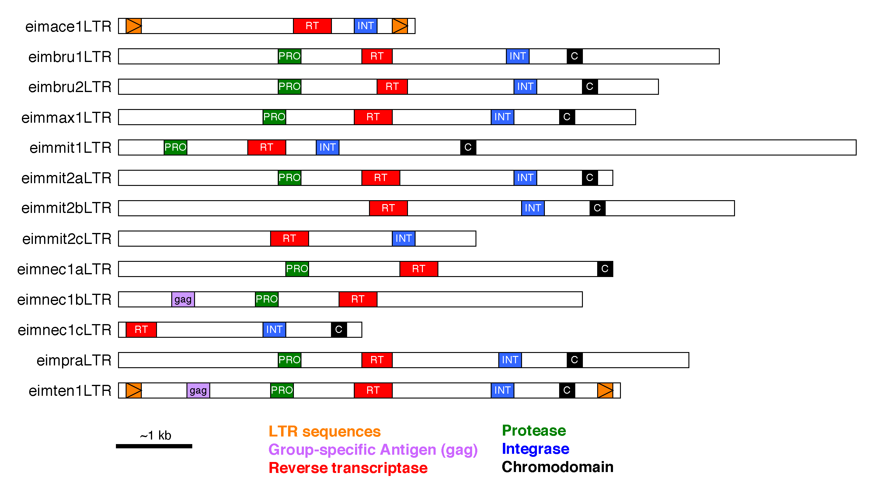
Chromovirus retrotransposons
Reid et al. (2014), Genome Research
Notes:
Previous analysis had identified something resembling transposons but they had not been characterised
We have shown that these are chromoviruses, a group of widely distributed retrotransposons.
No sort of retrotransposon has been seen in any other apicomplexan genome.
They appear to be degraded and show little evidence of retrotransposition but are expressed in many cases.
Their origin is currently unclear, but it is tempting to think they have remained in this lineage from the plant ancestor of the apicoplast.
Suggests intact retrotransposons might be found in other Eimeria/Apicomplexa

Slide 12
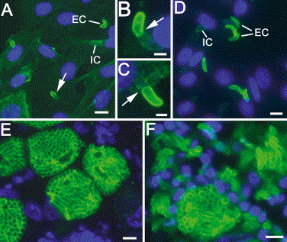
Eimeria surface antigens - SAGs
Sporozoites
2nd generation merozoites
Tabares et al. (2004)

Slide 13
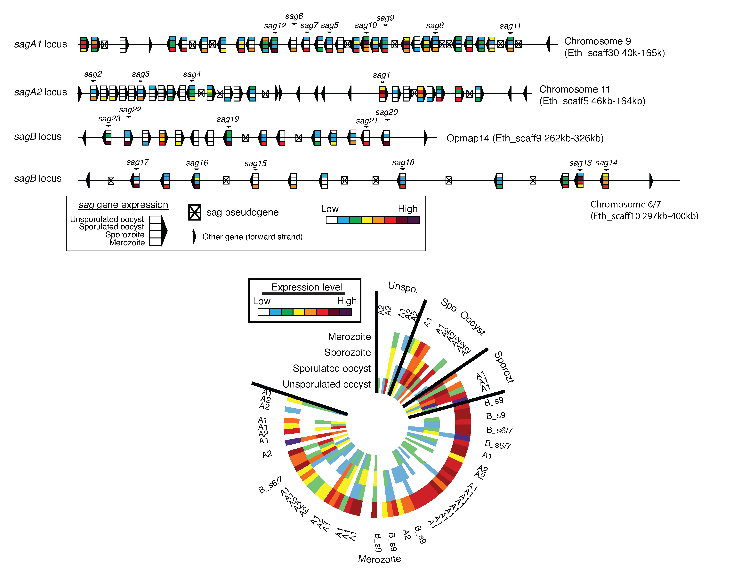
Reid et al. (2014), Genome Research

Slide 14
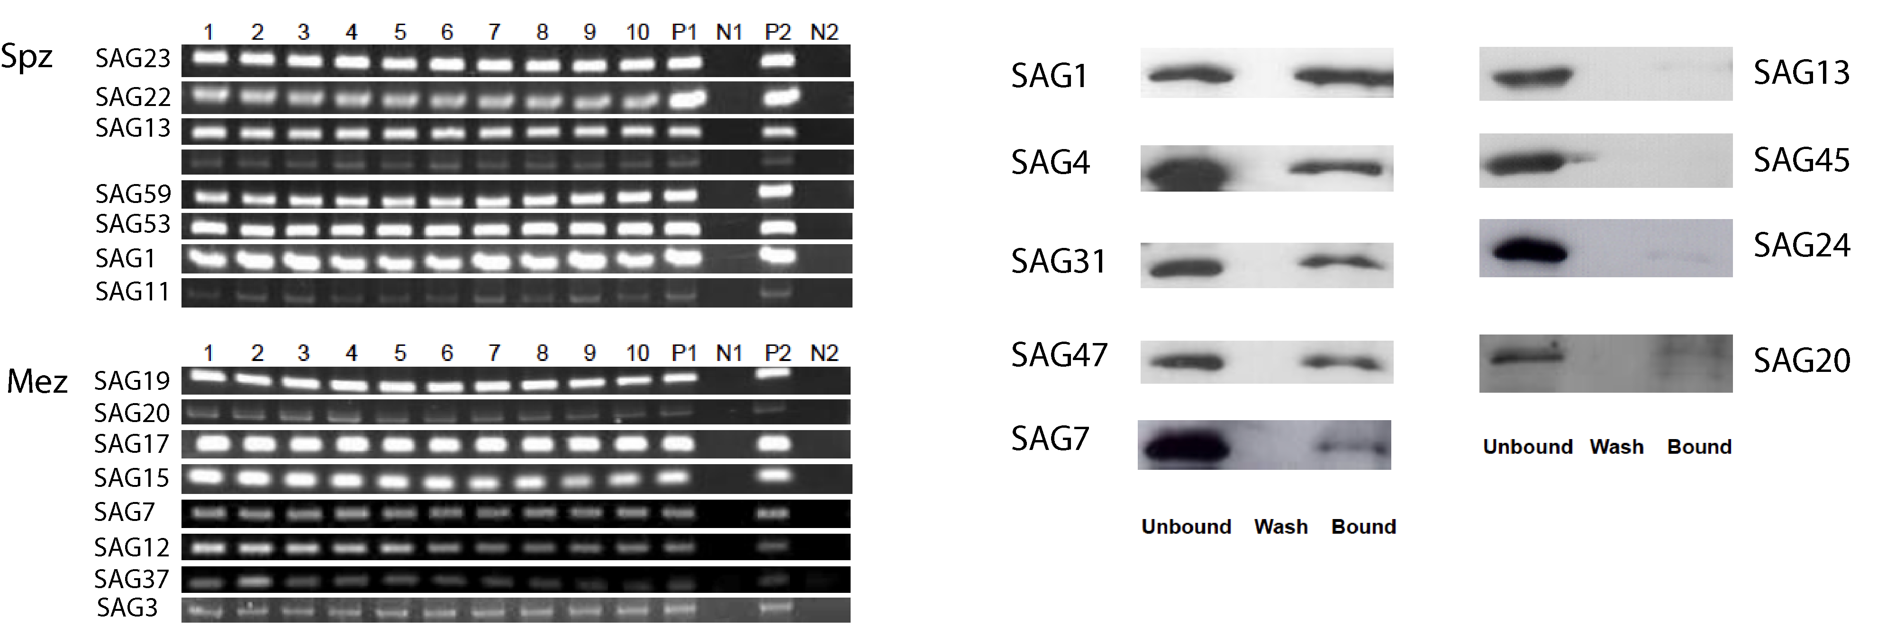
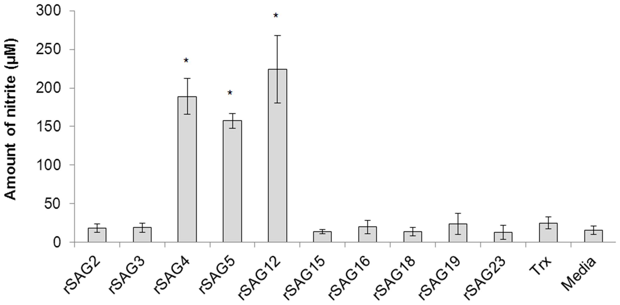
SAG function
Multiple genes expressed per parasite
sagA but not sagB bind host cells
Reid et al. (2014), Genome Research
Some members of sagA family but not sagB induce inflammatory response
Chow et al., PLoS One (2011)
Notes:
We have shown that multiple members expressed in a single cell
One subfamily bind host cells
Members of the same subfamily are known to induce and inflammatory response

Slide 15
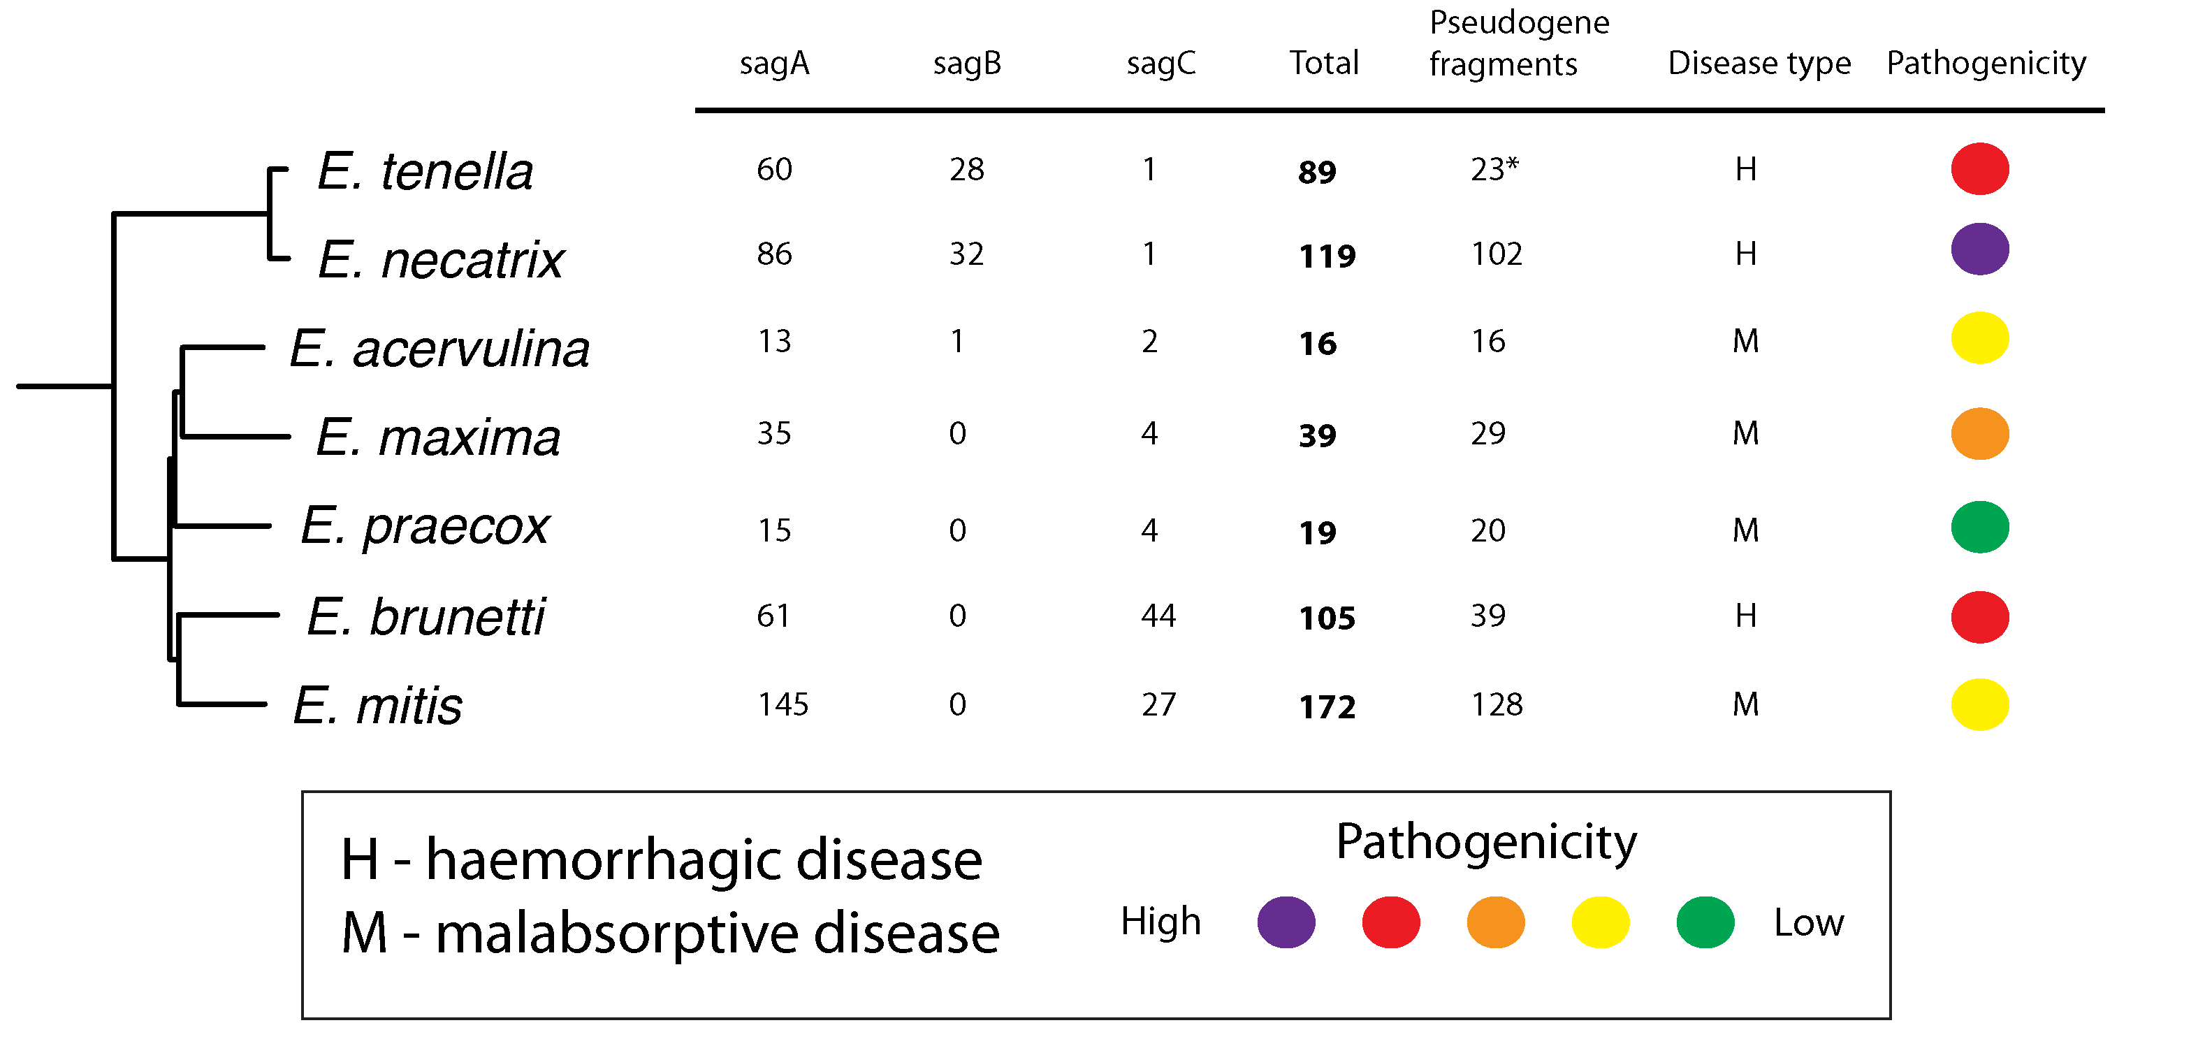
Distribution of sag subfamilies

Slide 16
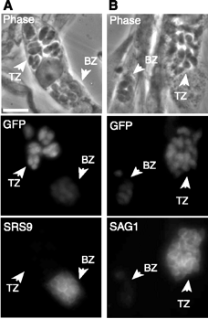
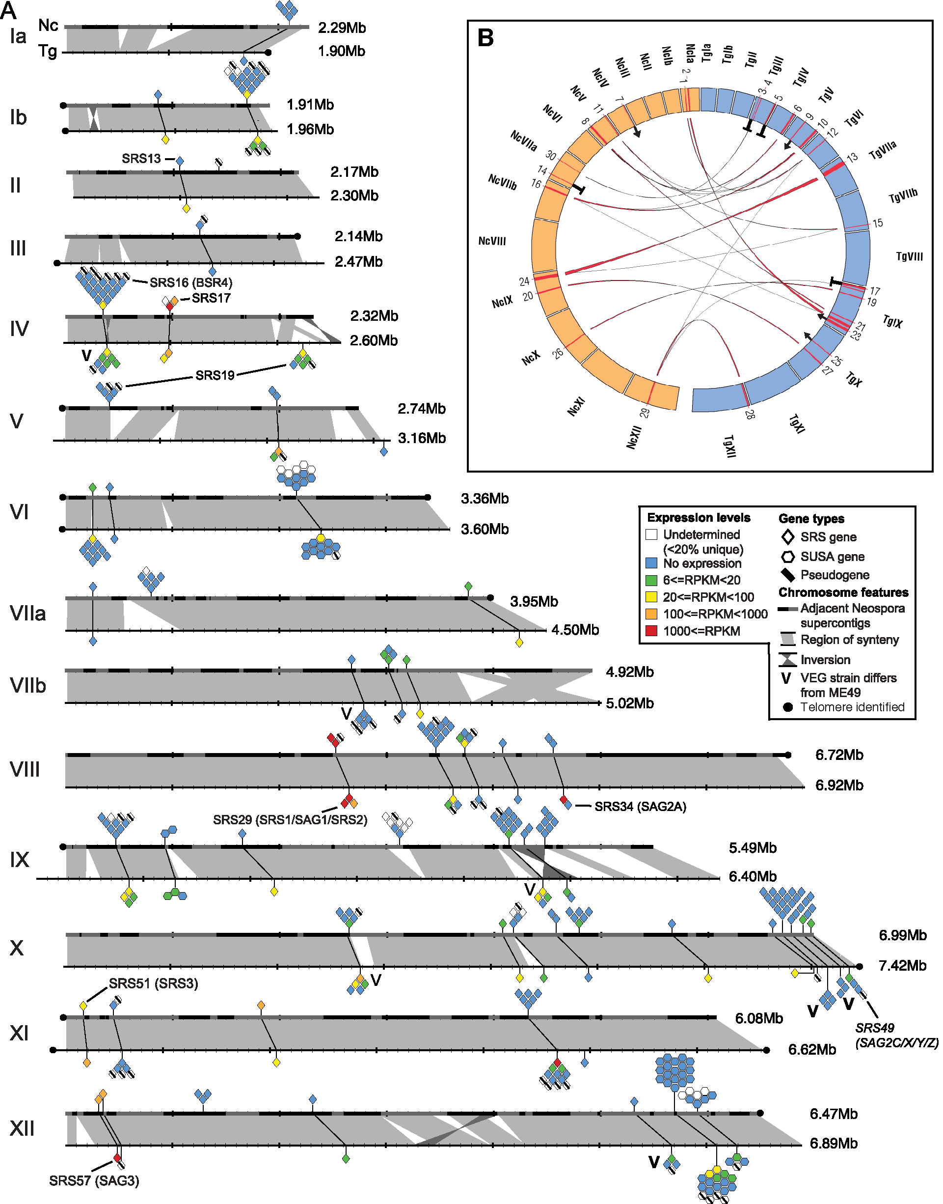
Toxoplasma surface antigen gene family (srs)
Multiple genes expressed at once
Simple structure
Many loci
Secreted/GPI-anchored
Immune evasion/cytoadherence
Reid et al. (2012). PLoS Pathogens
Kim & Boothroyd (2005).

Slide 17
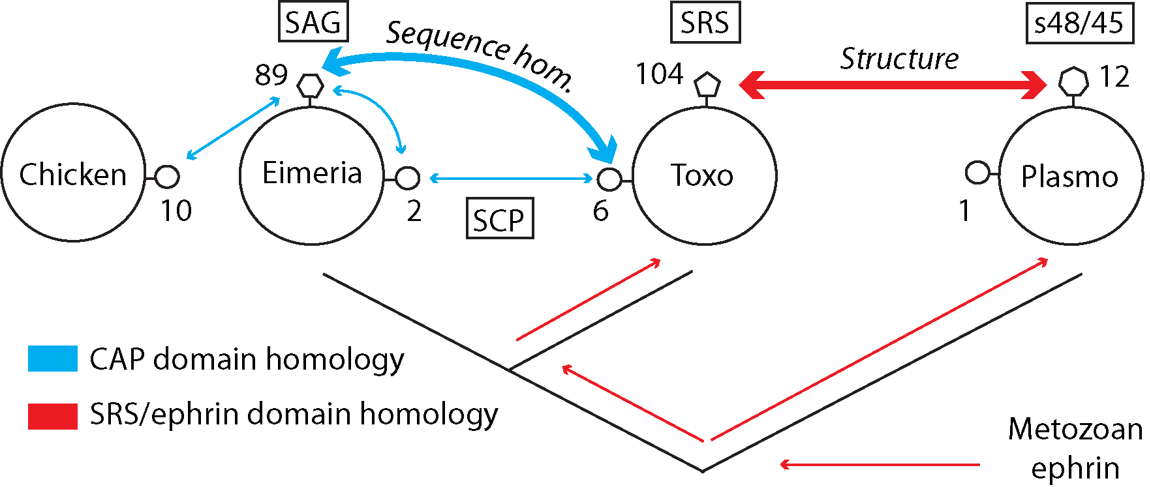
Evolutionary origin of SAGs
Reid et al. (2014), Genome Research
Arredondo et al., PNAS (2012)

Slide 18
Conclusions
Genome biology
The Eimeria proteome is the most repeat rich of any examined but we have no idea why
Chromovirus retrotransposons are present in apicomplexa
Host-parasite interactions
Eimeria surface antigens are similar in many ways to those of Toxoplasma and even Plasmodium pirs and ought to perform similar roles, but are evolutionarily distinct.
Notes:
Surface antigens appear to be relevant both for the simpler life cycle evolution and of course for host-parasite interactions

Slide 19
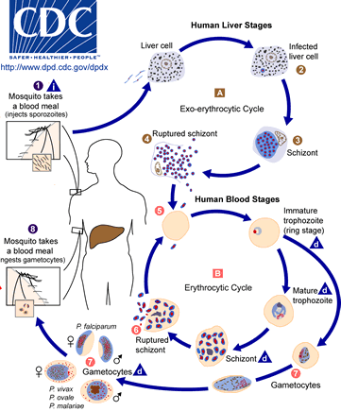
Vector-borne parasites establish chronic infections because their transmission is unpredictable
RNA-seq, long reads and chronic infection in malaria
Notes:
This may make it more difficult to design vaccines against them
To have a better chance we must improve our understanding of how they evade the immune response
Var genes are thought to mediate chronic infection through switching (as well as mediating cytoadherence and rosetting)
Models based on var gene switching do not account for chronic infections observed and vars are not found in any other malaria species, including several infecting humans, despite the establishment of chronic infections, cytoadherence and rosetting in these species.

Slide 20
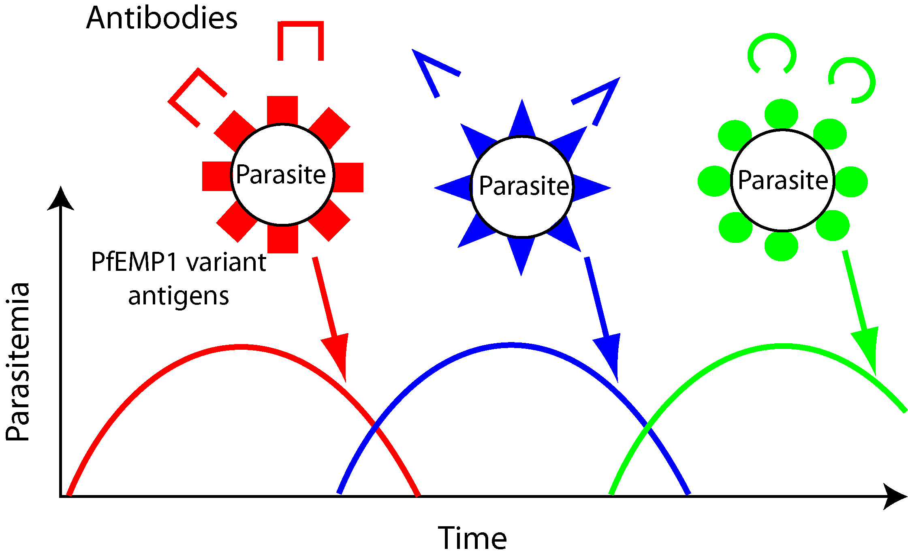
Antigenic variation in Plasmodium falciparum
Notes:
Var genes of P. falciparum are thought to mediate chronic infection through antigenic variation
Models based on var gene switching do not account for observed chronic infections
Vars are not found in most malaria species
We don’t understand early events

Slide 21
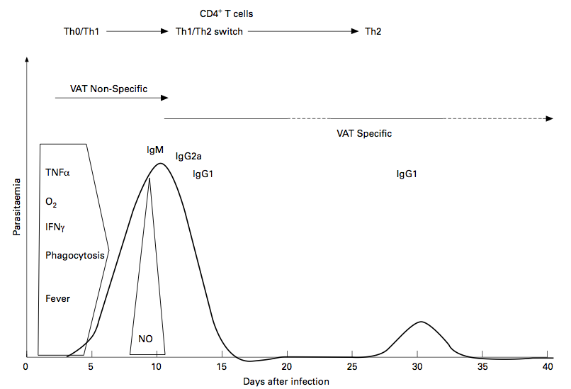
Immune response to P. chabaudi
peak of parasitemia (acute): 100uL of blood
Recrudescence (chronic): exsanguination
Blood sample (from the same mouse at those 2 different time points)
Purification of parasite RNA → RNA-seq
Thibaut Brugat
Philips et al. (1997). Parasite Immunology

Slide 22
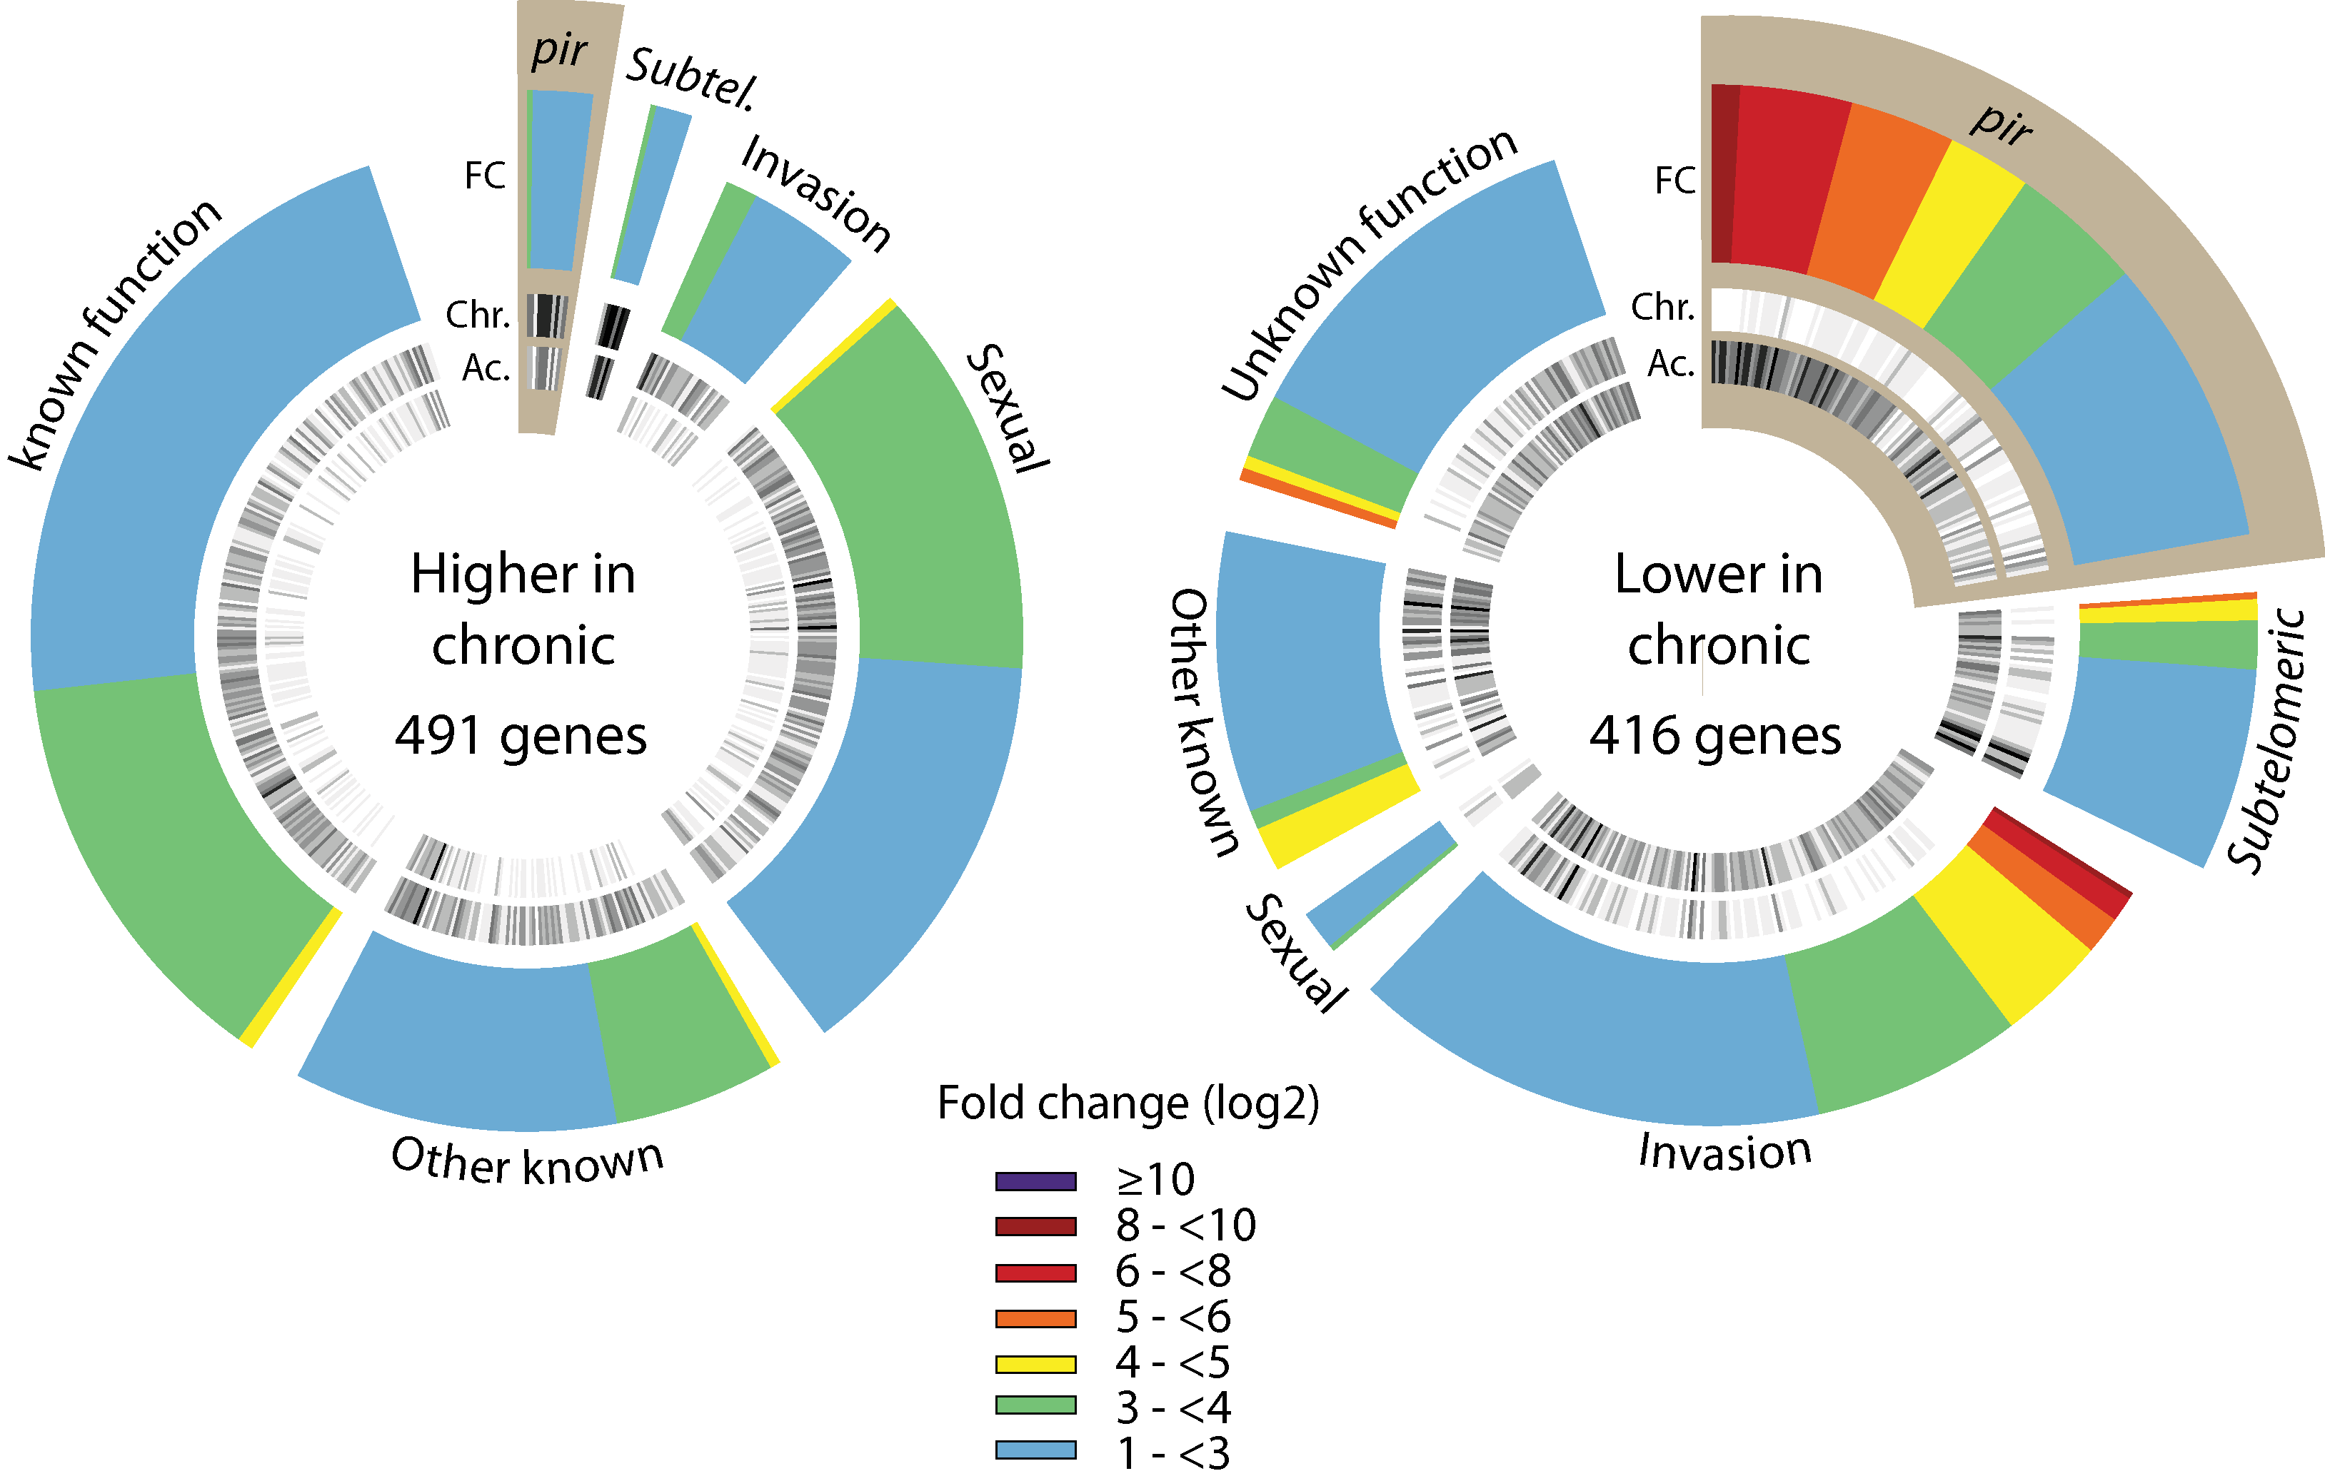
Chronic parasites express many fewer pir genes
Brugat, Reid et al. (2017), Nature Microbiology

Slide 23
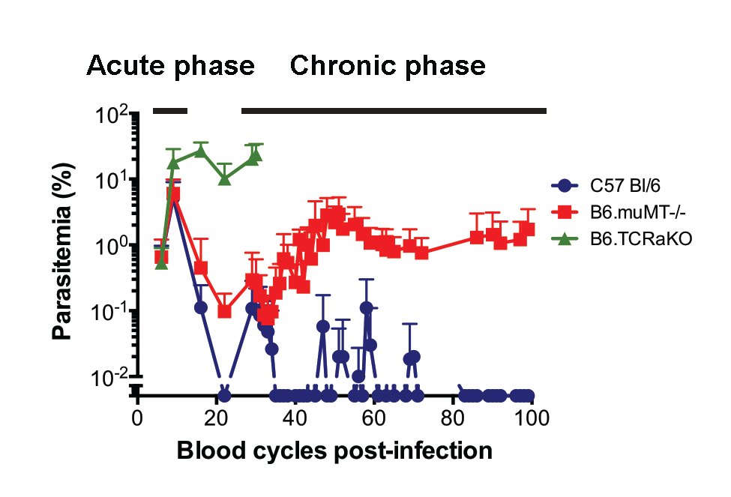
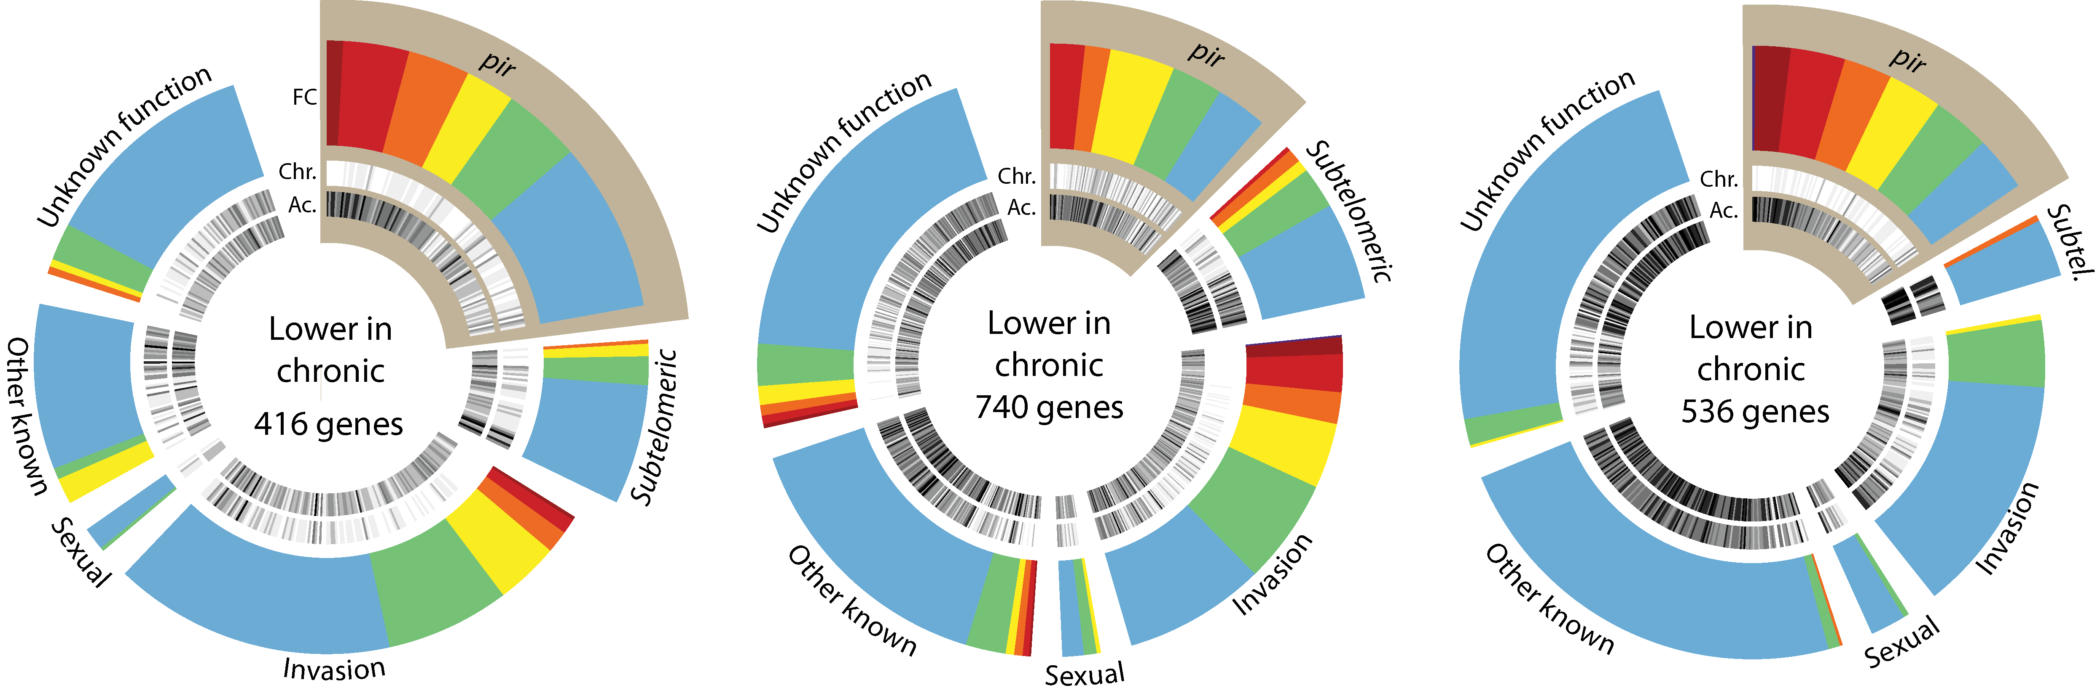
Are changes in gene expression consistent with antigenic variation?
Wild-type C57BL/6
B cell deficient
α/β T cell deficient

Slide 24
Conclusion I
Establishment of chronic infection does not involve the adaptive immune system and is therefore not mediated by antigenic variation.
It does however involve large changes in expression of pir genes.

Slide 25
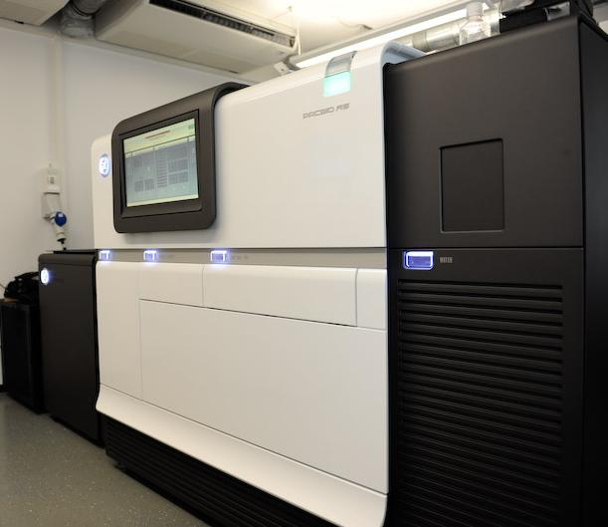
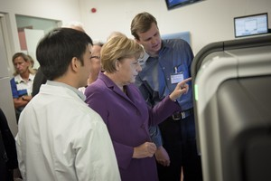
Finishing the Plasmodium chabaudi genome
Pir gene family is large and diverse and many were not placed into chromosomes in the v2 assembly (Otto et al, 2014)
The genomic context of these genes appears to be important
PacBio sequencer

Slide 26
Old and new assembly stats
Brugat, Reid et al. (2017), Nature Microbiology

Slide 27
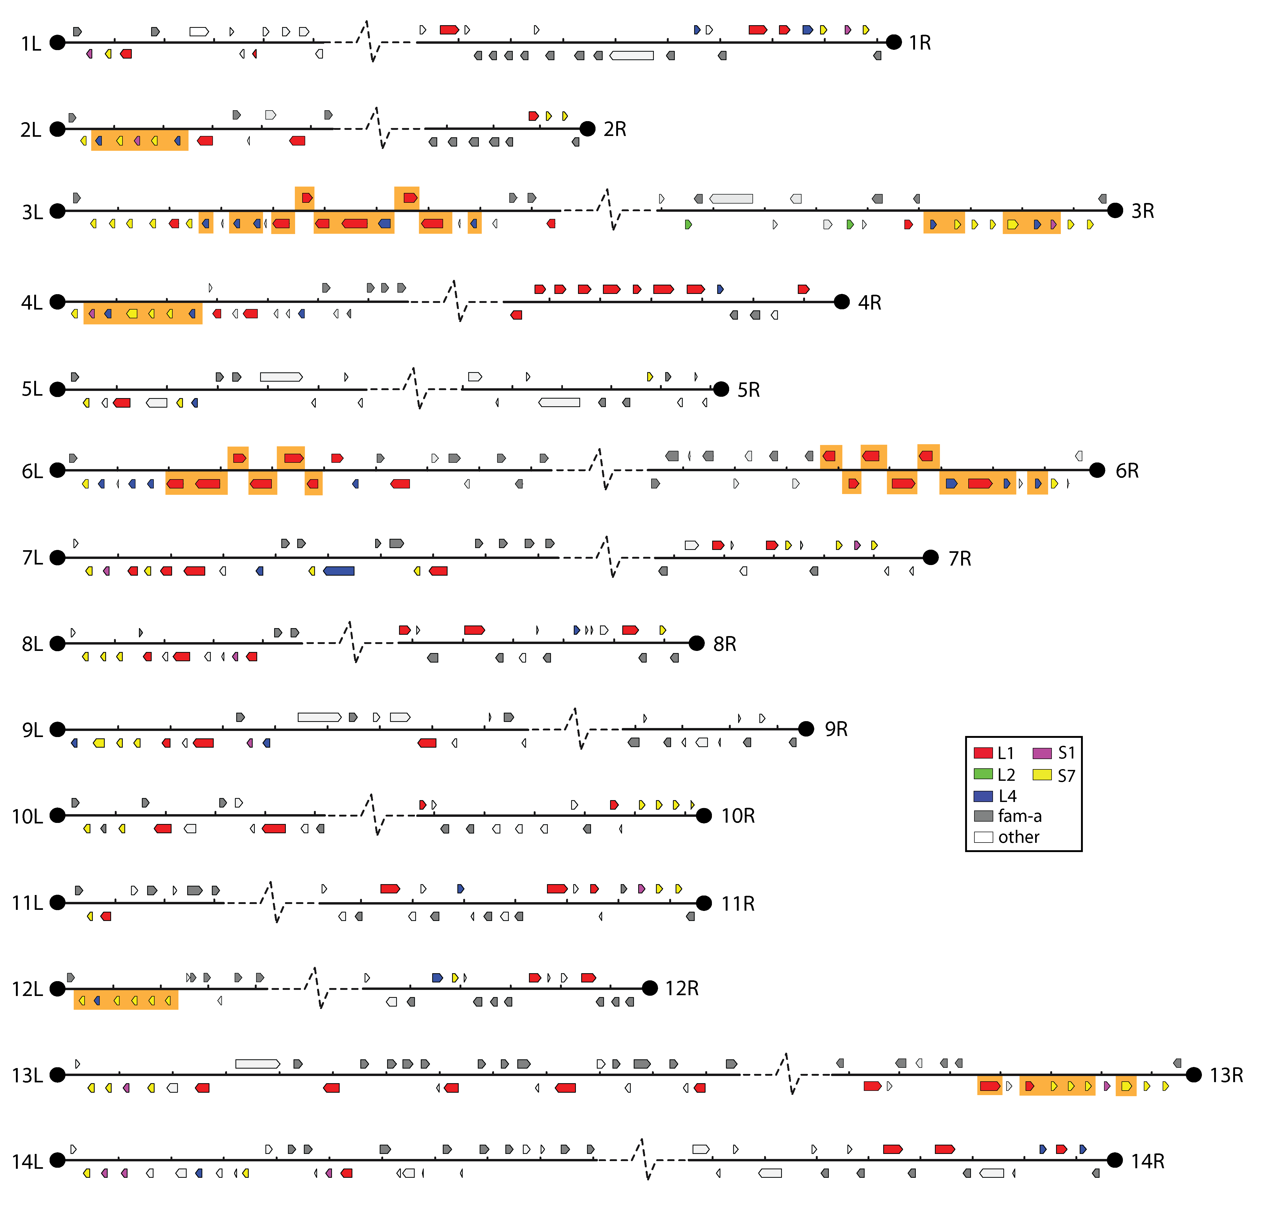
Clustering of pir genes

Slide 28
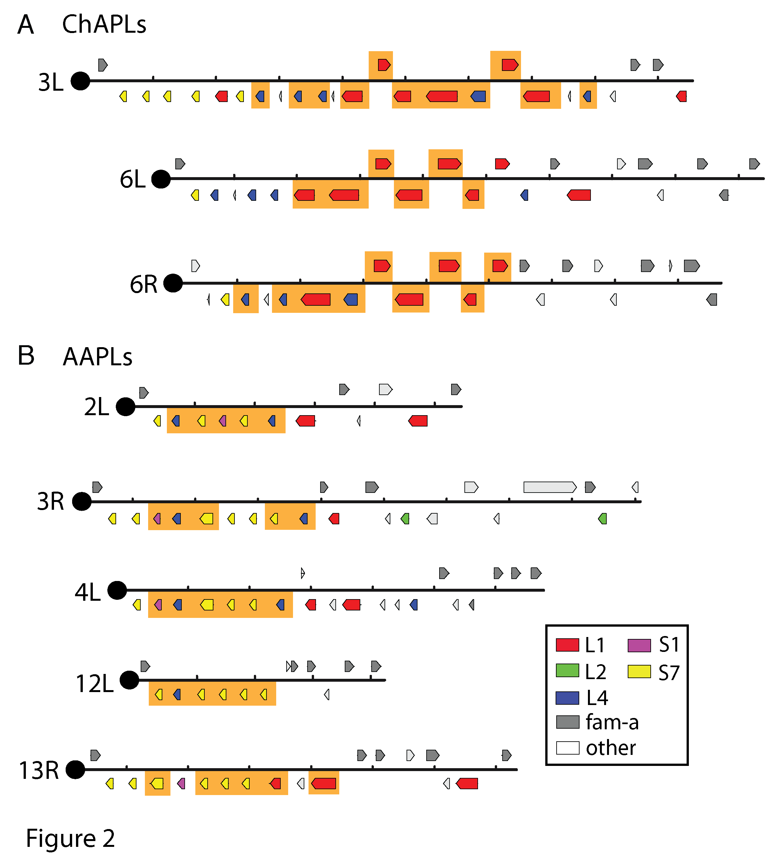
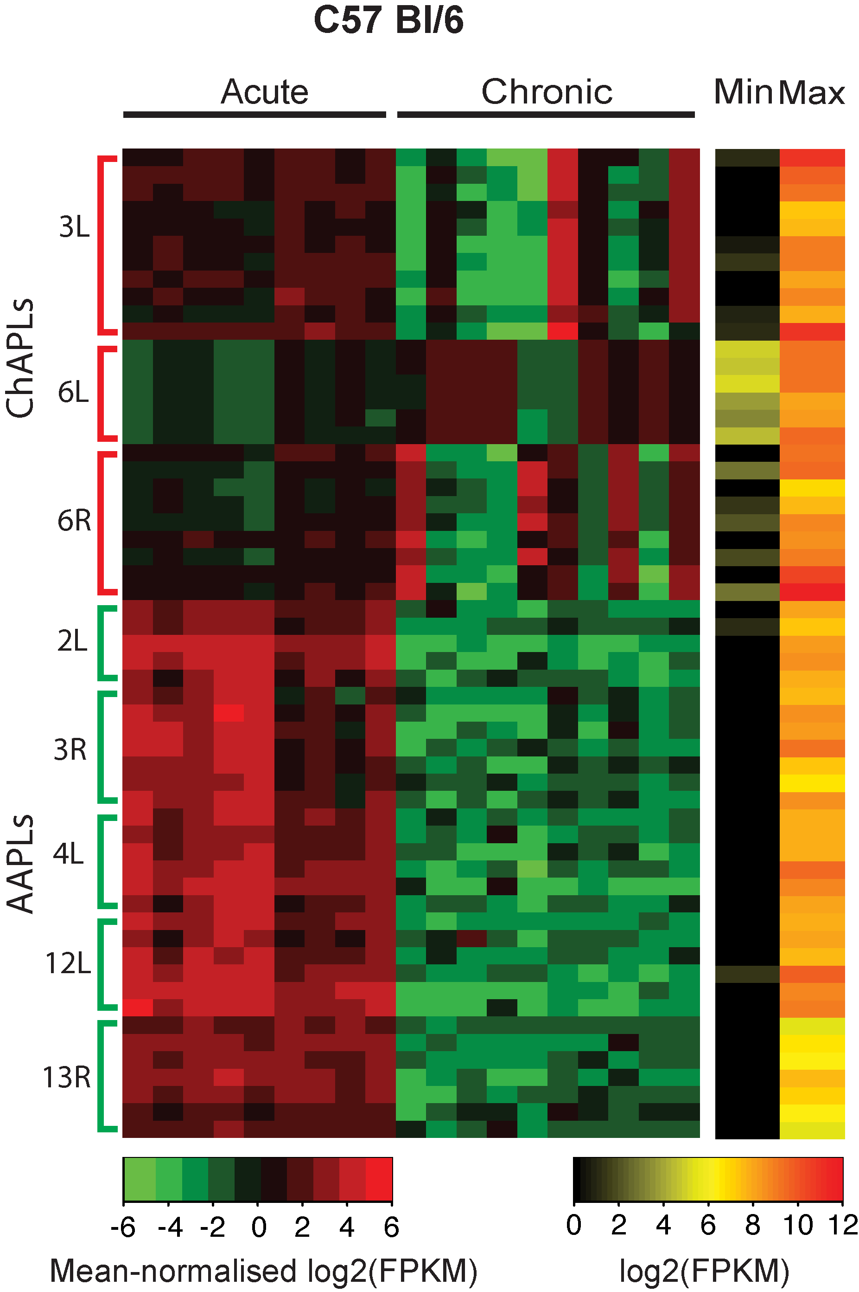
Distinctive pir gene loci are associated with chronicity
Brugat, Reid et al. (2017), Nature Microbiology
Notes:
General pattern of pir gene downregulation with a small number upregulated
In fact we see variation between mice
We see coexpression of particular loci

Slide 29
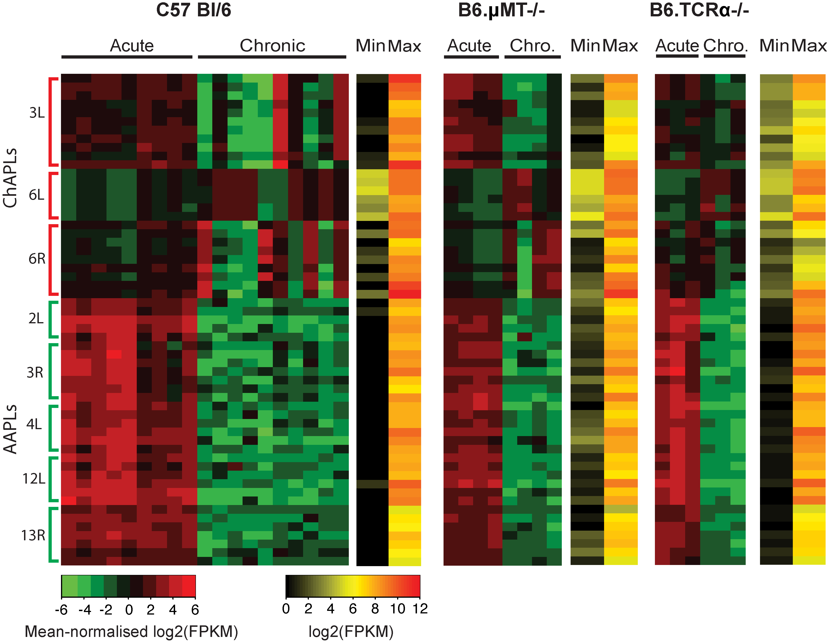
Increase in ChAPL expression is independent of the adaptive immune system

Slide 30
Conclusion II
Distinct clusters of pir genes are prominent in the acute phase of infection (AAPLs) and the chronic phase (ChAPLs).

Slide 31
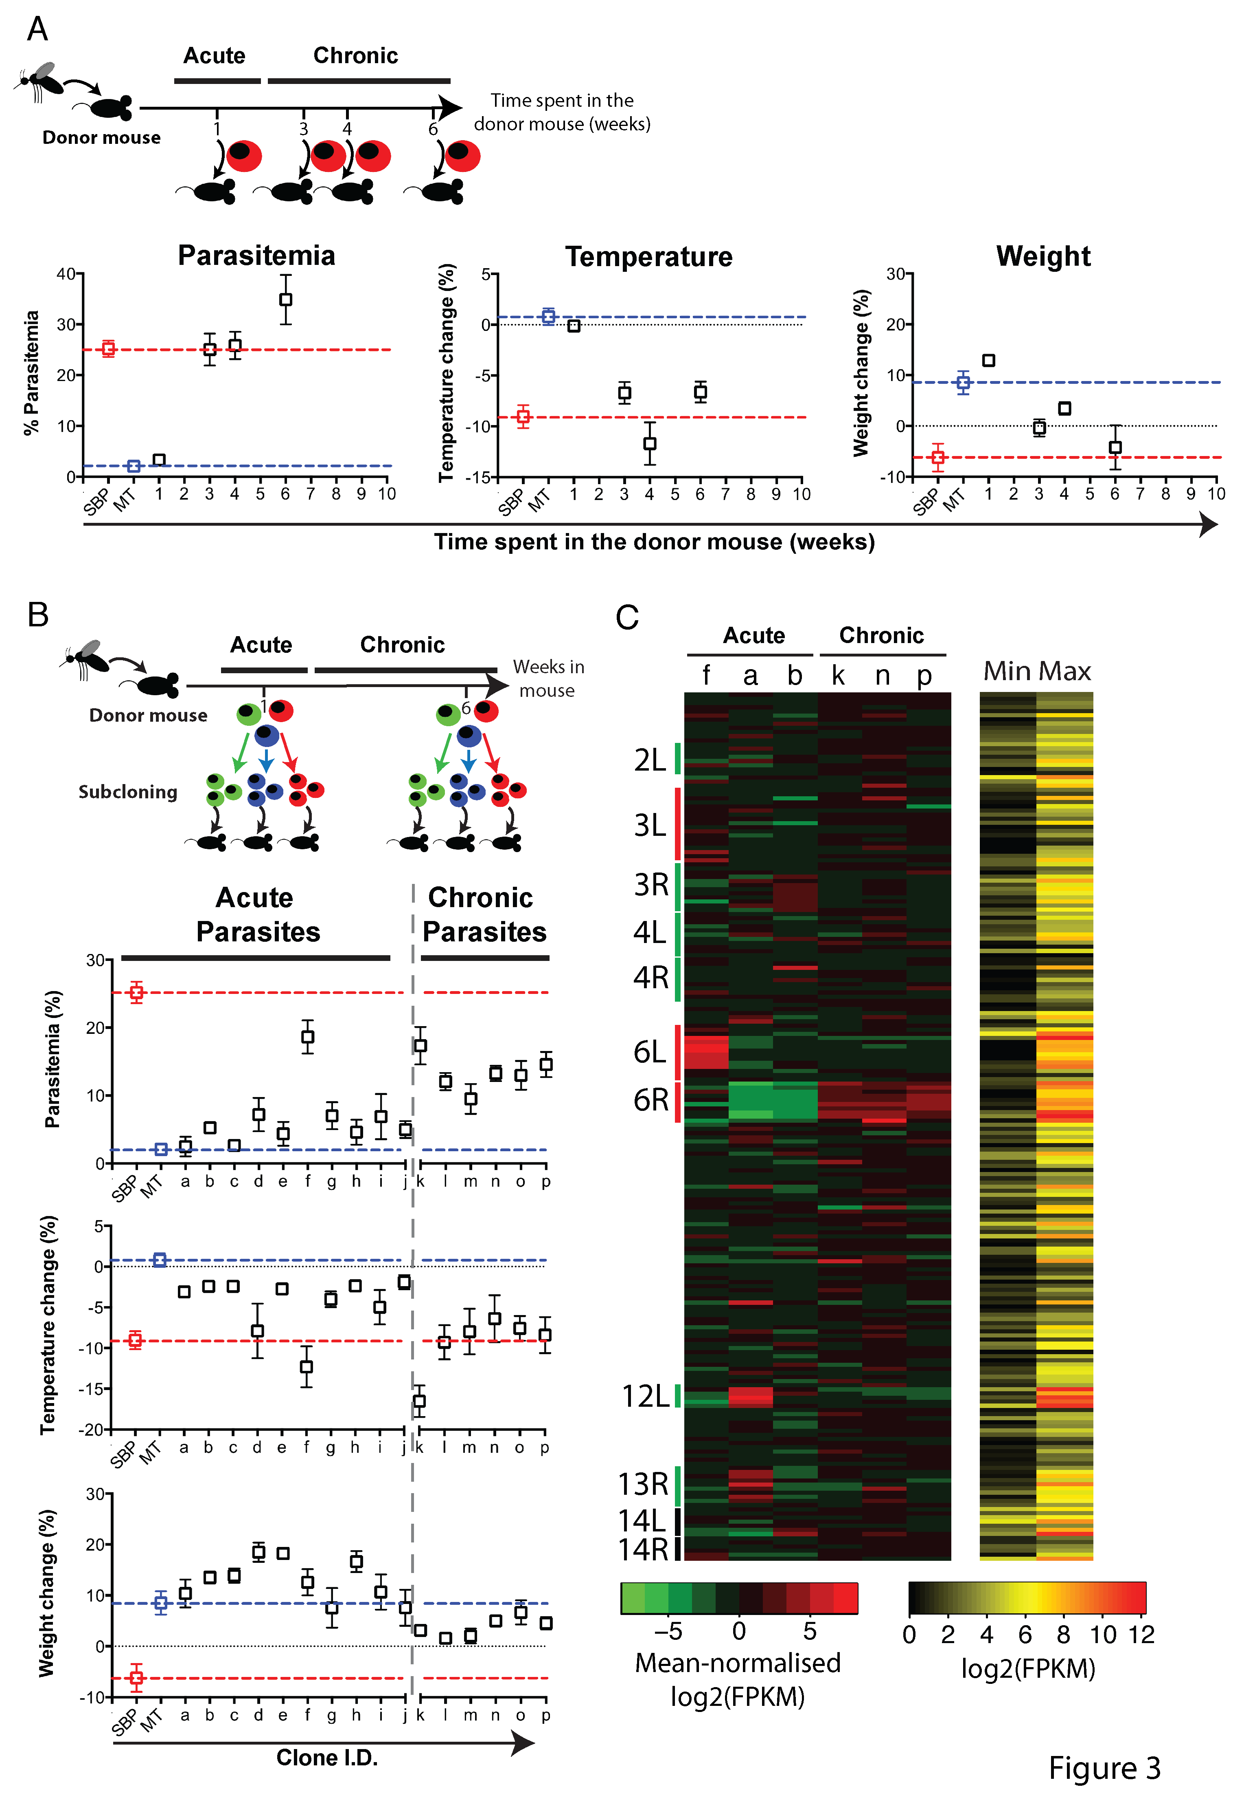
Do chronic parasites have a different phenotype?
Brugat, Reid et al. (2017), Nature Microbiology

Slide 32
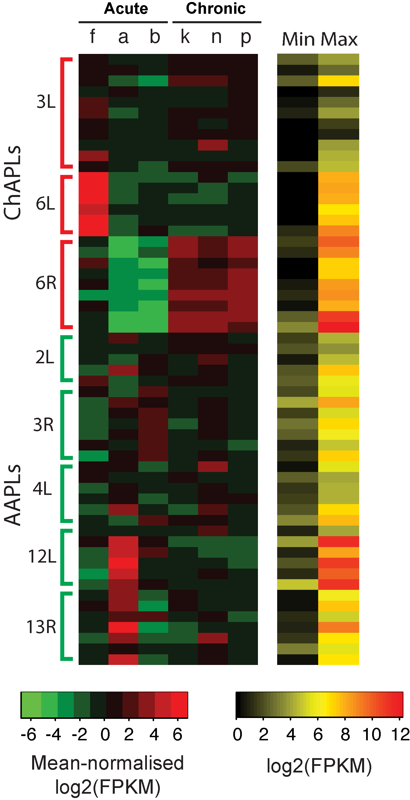
Do ChAPL-expressing parasites exist early in infection?

Slide 33
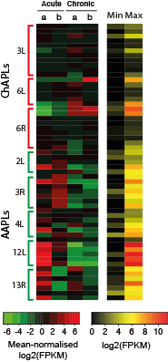
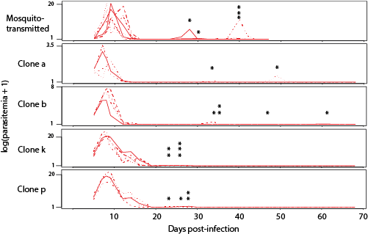
Can AAPL-expressing parasites establish chronic infection?

Slide 34
Conclusions
The acute phase is dominated by parasites expressing AAPLs, but a small proportion express ChAPLs.
ChAPL-expressing parasites come to dominate the chronic infection.
This change occurs independently of adaptive immunity and is therefore not antigenic variation.
Parasites can switch to ChAPLs to become chronic

Slide 35
Why is this important?
Vaccine development has proved very difficult for malaria.
Understanding of chronic malaria infection has focused on antigenic variation of var genes.
Var absent in most species
Don’t fully explain chronic infection
Little work in vivo, especially in early stages
However all malaria species have pir genes.
A universal means to establish chronic infection in Plasmodium?

Slide 36
Summary
Genome sequencing gives us access to the full complement of genes in an organism
Genomic context can give us clues about biology
Genomics+Bioinformatics does not give us silver bullets
Apicomplexa have an array of rapidly evolving genes which interact with their hosts
By better understanding these we hope to come up with new ways to defeat them

Slide 37
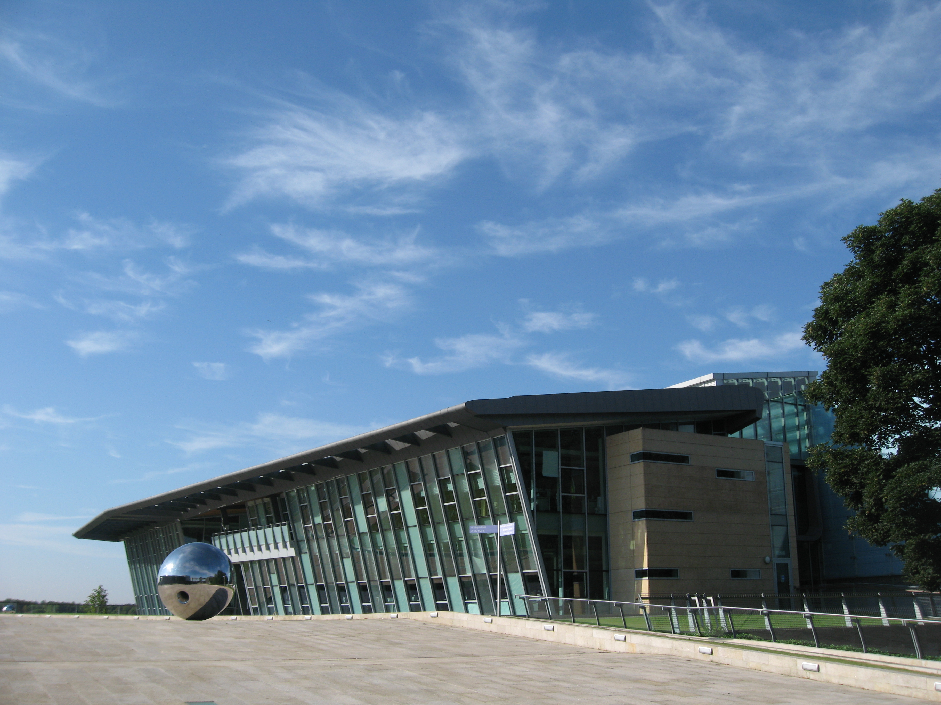

Eimeria acknowledgments
Wellcome Trust Sanger Institute
Thomas Dan Otto
Hardeep Naghra
Alejandro Sanchez-Flores
Hilary P Browne
Matthew Dunn
Mandy Sanders
Bart Barrell
Marie-Adèle Rajandream Matthew Berriman
KAUST
Arnab Pain
Hifzur Ansari
Tareq Malas
Mridul Nair
Yong Woo
Royal Veterinary College
Fiona Tomley
Damer Blake
Malaysia Genome Institute
Kiew-Lian Wan
Yea-Ling Tay
Pirbright Institute
Karen Billington
Chandra Subramaniam
Martin William Shirley
MRC LMB
Paul Dear
Universidade de São Paulo
Arthur Gruber
Sick Kids, Toronto
Stacy Hung
John Parkinson
Nippon Institute for Biological Science
Fumiya Kawahara
University of Liverpool
Alasdair Ivens
Immunology Frontier Research Center , Osaka
Diego Miranda-Saavedra
University of Copenhagen
Tobias Mourier
European Bioinformatics Institute, Cambridge
Neil Rawlings
Monash University
Christian Doerig
Centers for Disease Control and Prevention
Pierre Rivailler
Amgen Ltd
Xikun Wu

Slide 38


Plasmodium acknowledgements
Malaria work
Wellcome Trust Sanger Institute
Matt Berriman
Chris Newbold
Mandy Sanders
Ulrike Boehme
Thomas Dan Otto
The Francis Crick Institute
Jean Langhorne
Thibaut Brugat
Deirdre Cunningham
Sarah McLaughlin
Garikai Kushinga
Irene Tumwine
Sarah Amis
University of Edinburgh
Phil Spence

